Slide 1
Japan eData Submission Guide for NCCQP
As of Oct 2024
Hiroyuki Okamoto (NCCP, APJ R&D)
Confidential. For Internal Use Only.

Slide 2
Introduction
Purpose
This slide provides the guide to confirm a scope of electronic data(eData) submission and to prepare the eData package for J-NDA.
It’s recommended for Global and Japan NCCQP to follow the process shown in this slide.
Scope
Preparation of eData package related to NCCQP for all J-NDA and J-sNDA submission

Slide 3
Basic Flow of eData Submission
The applicant must confirm with the PMDA on the scope of the eData submission along with the appropriateness of the clinical data package by utilizing clinical trial consultations, a consultation on preparation of submission of electronic study data, and a consultation on expected review schedule, etc.
EOP2 consultation
Confirm the scope of the eData submission along with the appropriateness of the clinical data package
Consultation on expected review schedule
<Step 2>
J-NDA
<Step 3>
<Step 1>
Confirm the planned date of J-NDA
Final agreement on the scope of the eData submission, along with the appropriateness of the clinical data
Prepare and complete eData submission 2-5 weeks prior to J-NDA Note: PMDA takes at least 5 working days to validate submitted data, and the application will not be accepted until the validation is completed.
Applicant can have PMDA consultation on preparation and/or exemption of submission of electronic study data as needed
1-3M before J-NDA

Slide 4
Summary of materials to be submitted
Standard PK/PD
Analysis datasets* (e.g. Phoenix WinNonlin dataset, ADPC)
Dataset definition documents* (e.g. Define.xml)
Program files (e.g. Phoenix project file)
Analysis specifications (e.g. SAP)
PopPK/PD&ER
Analysis datasets (e.g. NONMEM dataset)
Dataset definition documents (e.g. Define.pdf)
Program files (e.g. NONMEM control file for base and final models)
Output files (e.g. NONMEM output file for base and final models)
Files on simulation (e.g. NONMEM / R script in the case the simulation results are used for decision making)
Program procedure
PBPK
Files on model structure, parameters, procedures etc.
Clinical study datasets including PK conc. data etc.
Dataset definition documents
+
TSV file
Note: The files listed in red must be submitted. Other files must be submitted if applicable.
* Not required when submitting CDISC dataset (e.g. ADPC, define.xml) for the clinical trial.

Slide 5
Standard PK/PD(NCA) 1/2
Analysis datasets
Analysis datasets for calculating PK or PD parameters and analysis datasets for statistical analysis using calculated PK or PD parameters (excluding the case where only summary statistics of parameters are derived) should be submitted.
The file format may be, for example, in the following format, but may be submitted in any format other than those listed below.
SAS XPORT format (*.xpt)
ASCII Format Data Files
Phoenix Projects (*.phxproj)
WinNonlin Files (*.pmo, *.pwo)
Dataset definition documents
The dataset definition document should include at least the variable names and the explanation of the variables and must be created by referring to Attachment 4. If the definitions are provided in the analysis result report, it would be sufficient to mention this fact and clearly state the relevant page number in the analysis result report.
The file format should, in principle, be as specified by the eCTD v4 notification PDF is preferred.

Slide 6
Standard PK/PD(NCA) 2/2
Program files
If there is any statistical analysis for PK/PD parameters, the program files should be submitted.
Analysis specifications
This will include detailed information on the analyses that were performed, such as the analysis algorithms (for example, the method used to calculate PK parameters) and the handling of data below the lower limit of quantitation. If this information is included in the analysis dataset itself [such as Text Output of Phoenix Projects (*.phxproj)], it would be sufficient as long as this is stated clearly. If this information is included in documents such as the analysis plan, it would be sufficient to just submit these documents.
Any file format is acceptable.

Slide 7
Population PK/PD Analysis 1/4
Analysis datasets <Packaged in “10_analysis_datasets”>
Analysis datasets corresponding to the program files of the model used to create the base model, final model, etc.
The file format may be, for example, in the following format, but may be submitted in any format other than those listed below.
SAS XPORT format (*.xpt)
ASCII Format Data Files
Dataset definition documents <Packaged in “10_analysis_datasets”>
The dataset definition document should include at least the variable names and the explanation of the variables and must be created by referring to Attachment 4. If the definitions are provided in the analysis result report, it would be sufficient to mention this fact and clearly state the relevant page number in the analysis result report.
The file format should, in principle, be as specified by the eCTD v4 notification PDF is preferred.

Slide 8
Population PK/PD Analysis 2/4
Program files <Packaged in “20_program_files”>
The program files at the time of analysis using the base model, final model, etc. should be submitted.
The file format may be, for example, in the following format, but may be submitted in any format other than those listed below.
ASCII Format Data Files
Output files with key results <Packaged in “20_program_files”>
The output files (e.g., NONMEM output) containing the results of the analysis using the base model, final model, etc.
Any file format is acceptable.

Slide 9
Population PK/PD Analysis 3/4
Files on simulation <Packaged in “30_files_on_simulation”>
When the simulation results are used for decision making, such as selection of the target population or setting of dosage and administration, the files related to the simulation should be submitted. In this case, simulation results include the results of posterior estimates of exposure parameters (AUC, Cmax, etc.) and other model-based posterior estimates.
The files related to the simulation should include a program file for generating simulation data, a program file used for conducting the simulation, and a program file for creating tables and figures showing the simulation results.
It is not mandatory to submit electronic data related to simulations conducted for model evaluation (e.g., Visual Predictive Check) or data sets generated in the course of the simulation.
If a dataset etc. related to existing information is used in the simulation, the dataset containing such information should be submitted. If a program cannot be submitted, a specification showing the algorithm shall be submitted.
Any file format is acceptable.

Slide 10
Population PK/PD Analysis 4/4
Program procedure <Packaged in “40_program_procedure”>
It shall describe the detailed procedures for executing the program. At a minimum, it shall include the name of the program file and a description of the program, and shall be prepared with reference to Attachment 5.
Note that if there is no need to specify path names or perform any other special processing in using the submitted program, it is basically not necessary to submit a program procedure.

Slide 11
PBPK Analysis
Files on model structure, parameters, procedures etc.
File containing information on the structure of the model used in the analysis, values of drug and physiological parameters, analysis results, sensitivity analysis, etc.
Any file format is acceptable.
Clinical study datasets including PK conc. data etc.
If the data set has been created or processed so that it can be analyzed by specific software, it is preferable to submit such electronic files (e.g., Simcyp PE Data Files (xml format)).
If the data set has not been created or processed for a specific software, any file format is acceptable.
Dataset definition documents (same as NCA)
When submitting a clinical study datasets including blood concentration data, etc., a dataset definition documents should be submitted as necessary.

Slide 12
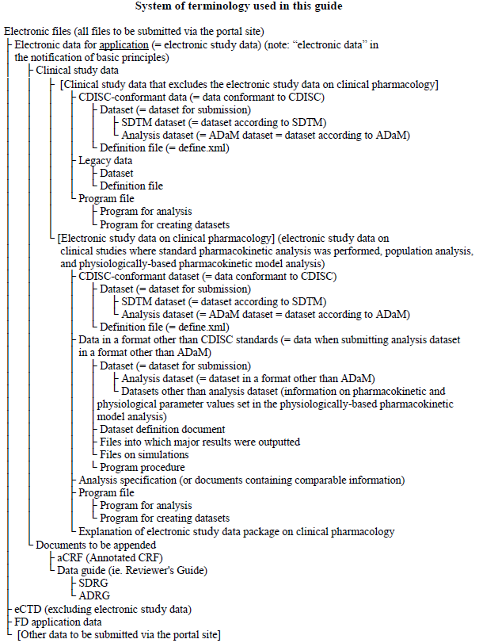
Attachment 1 System of Terminology Used in This Guide

Slide 13
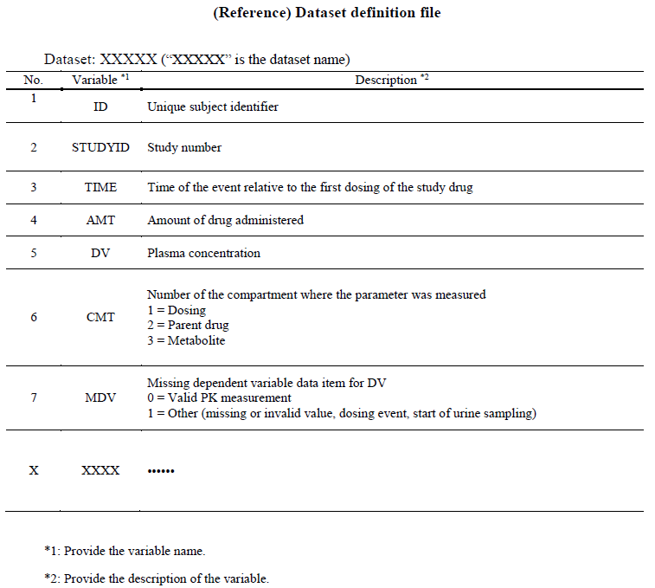
Attachment 4 Dataset Definition Document
Example

Slide 14
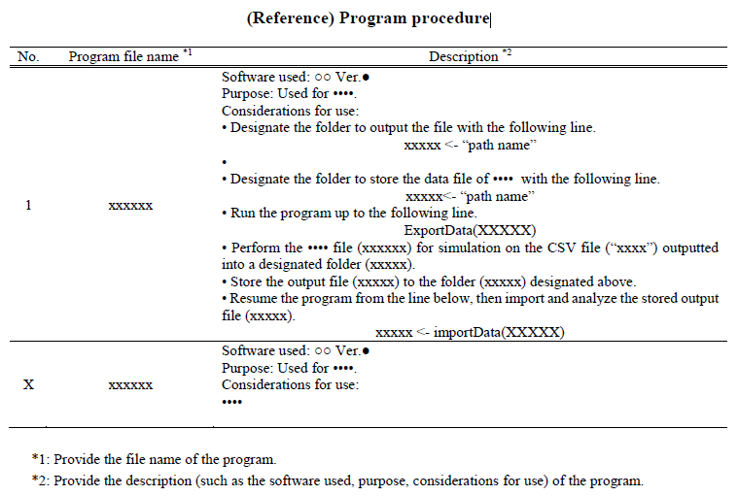
Attachment 5 Program Procedure Document
Example

Slide 15
Explanation of Electronic Study Data Package on Clinical Pharmacology
Since electronic data in the field of clinical pharmacology are stored in various folders and file names, PMDA will use the “Explanation of electronic study data package on clinical pharmacology” to check and use the submitted electronic data. The “Explanation of electronic study data package on clinical pharmacology” will be entered in the gateway system when the electronic data is submitted through the gateway system or created by PMDA based on the information on the submitted clinical trial data described in the XML message of the eCTD. When creating the “Explanation of electronic study data package on clinical pharmacology”, it is necessary to enter the Analysis Type appropriately, as the information entered in the Analysis Type is used to identify the file for the clinical pharmacology area.
When submitting electronic files to the counter due to unavoidable circumstances, it is acceptable to submit TSV files, except when referencing from XML messages in the eCTD.
The information used by PMDA to prepare the “Explanation of electronic study data package on clinical pharmacology” is as follows.
Study ID: A string that identifies each study.
File path: The file path from the m5 folder, from which the file name information is also obtained. Note that when electronic data is submitted through the gateway system, the gateway system automatically reads the file path, except in the case of referencing from the XML message of eCTD, so input of the file path is not necessary.
Analysis Type: Type of analysis performed (STS, POP, PBPK, or Other) For clinical data that are not electronic data for application in the area of clinical pharmacology (see Attachment 1), enter “Non-CP” in all files. STS includes PK/PD analyses that are analyzed in the same manner as standard pharmacokinetic analyses, and “Other” should be entered for studies or analyses in the clinical pharmacology field that are not considered to fall under either STS, POP, or PBPK.
Description: A description of the contents of the file, used when Analysis Type is STS, POP, PBPK, or Other. It is necessary to describe each file in detail so that its purpose and relationship with other files can be specified. The maximum number of characters that can be entered is 100.

Slide 16
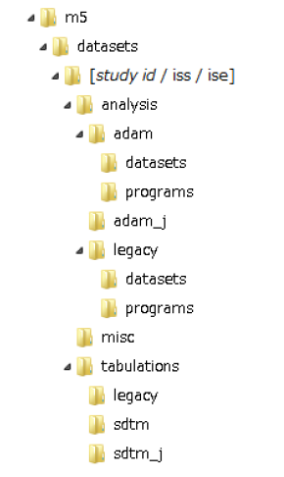
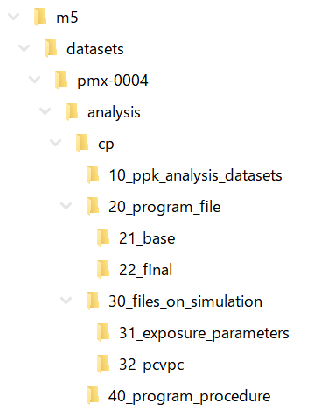
Folder Structure 1/3
In principle, electronic study data should be submitted after storing it in thefollowing folder structure, and no additional subfolders should be created. If storing the data in the following folder structure is difficult, the applicant must consult the PMDA beforehand and make a submission after agreeing on the folder structure and the storage of files. Hierarchies down to “m5¥datasets¥[study id / iss / ise]”cannot be changed.
Example: ALXN1210-MG PopPK analysis (pmx-004)

Slide 17
Folder Structure 2/3
Note the following points when storing the electronic study data into the abovementioned folder structure.
The path length counting from the “m5” folder, including the file name, must be 160 characters or shorter.
Folder names should be 32 characters or fewer, and must be comprised of the following characters.
Alphabetic characters from “a” to “z” [U+0061 to U+007A]
Numbers from “0” to “9” [U+0030 to U+0039]
Low line “_” [U+005F]
Hyphen-minus “-” [U+002D]
File names should be 32 characters or fewer for datasets and 64 characters or fewer for files other than datasets (including the extension), and the name excluding the dot and the extension must be comprised of the following characters.
Alphabetic characters from “a” to “z” [U+0061 to U+007A]
Numbers from “0” to “9” [U+0030 to U+0039]
Low line “_” [U+005F]
Hyphen-minus “-” [U+002D]
The data guide, define.xml, and style sheet must be stored in the same folder as their corresponding dataset. The style sheet should display the information in the define.xml, which is to be submitted to the PMDA.
If there is no file to store the data, this folder should not be created.
When storing the electronic study data in the field of clinical pharmacology in a format other than the CDISC standard, one example is to create and store it in a “cp” folder under the “analysis” folder as mentioned in the table below. In such a case, there will be no special restriction on the folder structure within the “cp” folder. The method of storing the data is not limited to that mentioned above. However, regardless of the method of storage, the above considerations on path length, folder name, and file name must be followed. It is preferable to consult the PMDA beforehand on the method of storing the data.” is as follows.

Slide 18
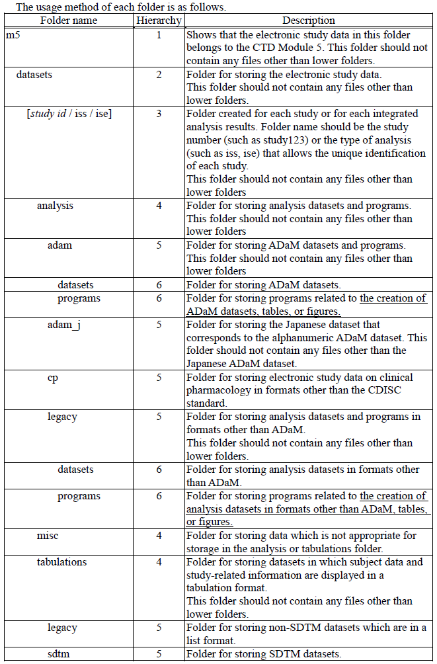
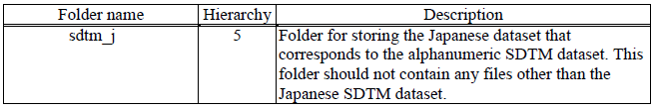
Folder Structure 3/3

